Slide 1
Wawrzyniec Konarski Jagiellonian University in Cracow, Poland w_konarski@op.pl
Ethnicity and Politics
in Central Europe:
selected aspects
Lecture prepared for the Visegrad Winter Seminar,
Széchenyi István Egyetem,
Györ, February 24-28, 2014

Slide 2
Ethnicity and Politics
1. KEY TERMS:
Ethnicity - the term derives from the Greek ethnikos, the adj. of ethnos, what refers to a company, people or nation.
The category of ethnicity was introduced into sociology and political science by David Riesman in 1953. Nathan Glazer and Daniel P. Moynihan defined it as „(...) a tendency by people to insist on the significance of their distinctiveness and identity and on the rights that derive from this group character”.

Slide 3
Ethnicity and Politics
In most cases the term ethnicity is equivalent for ethnic group. The latter remains a long-lasting object for research analysis.
Max Weber in his classic approach refers to an ethnic group as a human collectivity based on an assumption of common origin, real or imagined.

Slide 4
Ethnicity and Politics
Ellis Cashmore defines it as self-conscious collection of people united, or closely related, by shared experiences.
Thus the elements of vital importance for an ethnic group are usually: culture, especially language and religion; genealogy, including race and origin; special personality features and occupied territory (Antonina Kłoskowska; Ewa Nowicka; Ronald A. Reminick).

Slide 5
Ethnicity and Politics
Politics - an activity which makes it possible to reconcile the interests of various social groups living at an area subject to one power, by granting them the access to the power proportionally to their importance for survival and well-being of the whole community (Bernard Crick).

Slide 6
Ethnicity and Politics
However, such liberal-democratic approach narrows down the historically verified meaning of the term politics and omits the fact that the history of mankind has shown very clearly that politics in the form of war is also politics (Carl P.G. von Clausevitz).
Effective politics depends on the own goals fulfilment both by political and military means, with the possibility of changing the allies (lord Palmerston).

Slide 7
Ethnicity and Politics
Ethnopolitics is understood as a concept that refers to all types of politics involving ethnic entities (Rasma Karklins) or as a process of ethnicity’s translation into political space (Joseph Rothschild). Ethnopolitics may have Ianus-like image: constructive and destructive one, for it may legitimate and delegitimate political systems of states, and stabilize or udermine their regimes and governments.

Slide 8
Ethnicity and Politics
This ambigous image is confirmed by John T. Ishiyama and Marijke Breuning by saying that although ethnopolitics can be conflictual, it can also be cooperative. They also claim that the organizational expression of ethnopolitics is the ethnopolitical party. However, not only. As manifold exemples confirm paramilitary aspect cannot be neglected here, to remind IRA, ETA, Hlinkova garda, Magyar Gárda and many others.

Slide 9
Ethnicity and Politics
The term ethnicity remains in close connection with the national identity. In political terms the national identity is pursued by the term nationalism perceived in double, but referring to each other notion as ideology (integrative one) and socio-political attitude. Nationalism goes back to the European Enlightenment time and its first appearance sometimes is coincided with 1798? (Bertier de Sauvigny).

Slide 10
Ethnicity and Politics
Nationalism is the ideology of nation. The latter term is an elastic concept, which - due to the European intellectual traditions acknowledged by Jean Jacques Rousseau and Johann Gotfried Herder - refers to two basic dimensions: the political and ethnocultural, hence the adopted division on political and ethnic nations. This typology should be perceived as a result of problems arising from the divergence of state and ethnic boundaries within the European realities.

Slide 11
Ethnicity and Politics
Where there is a long tradition of a state based on a particular nation, like England, France or Denmark, whose identity and independence was almost never questioned, nationhood, although based on an ethnic identity (eg. language), acquired more or less political (equal rights on certain territory) overtones. Thus the concept of political nation refers in most cases to those entities with strong and long lasting tradition of independent statehood even in its dynastic understanding.

Slide 12
Ethnicity and Politics
Where the tradition of a state was interrupted (either as a result of foreign conquest such as in Bulgaria, Hungary, Poland or Serbia, or as a result of political fragmentation, such as in Germany and Italy), the awareness of a twofold dimension of nationality political and ethnic – remained more alive. Thus the concept of ethnic nation refers in most cases to those entities with strong and long lasting tradition of separate culture existence, namely a language and/or religion (despite the lack of statehood).

Slide 13
Ethnicity and Politics
Europe's most important geographical distinction is that no point is very far from an arm of the ocean. This has been a key to its development, for it has given Europeans easy access to the rest of the world. Due to some interpretations there are five basic regions of Europe:
1) Western Europe;
2) Eastern Europe (& Central as its sub-region, often perceived as an amalgamation of both terms);
3) Southern Europe;
4) Northern Europe;
5) British Isles.

Slide 14
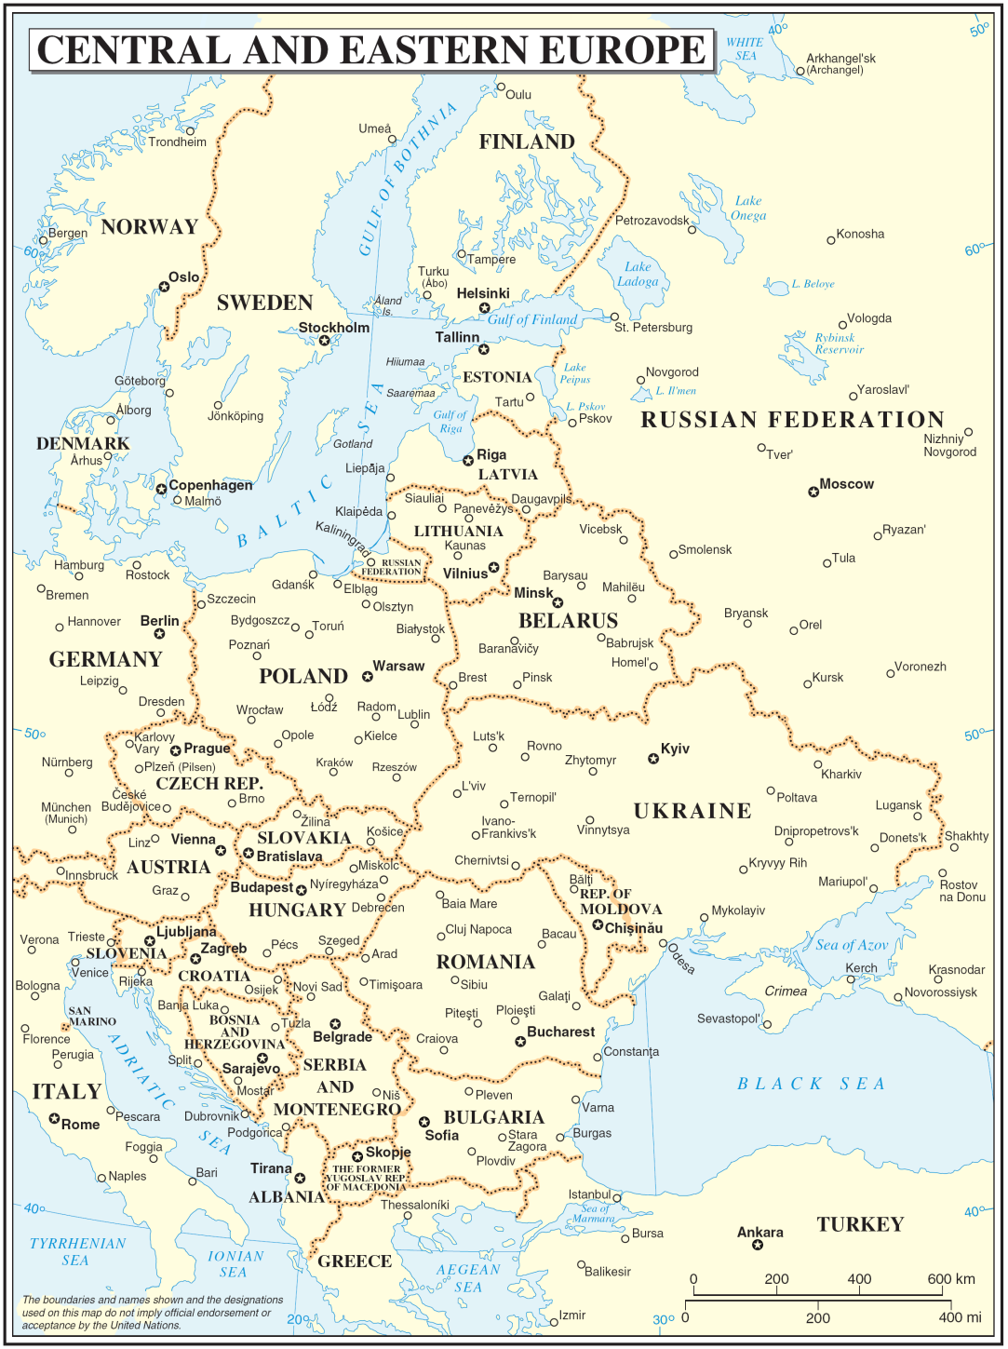

Slide 15
Ethnicity and Politics
Literary the term Eastern Europe – until the end of WW I – referred to the European territories controlled by Austria-Hungary, Ottoman Empire and tsarist Russia.
The multinational powers’ political domination over peoples living in the region was reflected by: Turkish and Russian despotism, Austrian autocracy, and Prussian militarism (with reference to part of former - first - Polish Commonwealth partitioned by Prussia).

Slide 16
Ethnicity and Politics
In most cases the Central Europe is currently (after 1989) identified with four countries, namely Poland, Czech Republic, Slovakia and Hungary. However there are some speculations whether to include Croatia and Lithuania into this space (Janusz Stefanowicz).

Slide 17
Ethnicity and Politics
2. ETHNICITY as a POINT of REFERENCE for SELECTED POLITICAL PARTIES in CENTRAL EUROPE:
Poland
Ethnic aspect s in historical parties’ profile:
National Democracy (Narodowa Demokracja, ND) of Roman Dmowski, est. 1887 – Poland as ethnonationally homogeneous state, pro-Russian, anti-Semitic & anti-German + its extreme wing - National-Radical Camp (Obóz Narodowo-Radykalny, ONR), est. 1934 – extremely anti-Semitic & fascinated with fascism.

Slide 18
Ethnicity and Politics
Sanification (Sanacja) or Piłsudskities (Piłsudczycy) or the Józef Piłsudski camp, formed in 1926 - initially Poland as multicultural federation, but anti-minorities image furthermore, anti-Russian & anti-Soviet;
National minorities’ parties – anti-Polish state orientation from German & Ukrainian minorities in particular.

Slide 19
Ethnicity and Politics
Within the largest Polish political parties today both leading traditions, namely nationalist of ND and Piłsudskities are combined by Law and Justice (Prawo i Sprawiedliwość) party of Jarosław Kaczyński, est. in 2001.
Until recently this profile was maintained by League of Polish Families (Liga Polskich Rodzin, LPR) - a moderate version of former ND, est. in 2001, but currently in decline.

Slide 20
Ethnicity and Politics
Ethnic aspects in other current Polish parties:
National Movement (Ruch Narodowy, RN) et al., est. in 2012 as a common initiative of radical nationalism camp, close to the pre-war ONR – anti-German, panslavic (but anti-Russian imperial stance) & anti-EU.
Movement for the Autonomy of Silesia (Ruch Autonomii Śląska, RAŚ), est. in 1990 - ethnoregionalistic, anti-centralisation orientation & for regional autonomy.

Slide 21
Ethnicity and Politics
Czech Republic
Two leading political competitors & concepts in newest history :
Tomáš Garrigue Masaryk - political rationalist, leader of Progressive Party (Česká Strana Pokroková), 1900-1918 & president od Czechoslovakia in 1918-1935 - attitude of enmity towards Hungarians & Poles, conciliatory towards Germans.
Karel Kramař – panslavist, leader of Czechoslovak National Democracy (Československá národní demokracie), 1919 -1938 – pro-state right-wing party.

Slide 22
Ethnicity and Politics
The ethnic aspects in minor Czech parties today:
In the years after 1989 the hatred towards Roma (and some other minorities, eg. Poles) remains in use especially by four political parties: 1/ Republicans of Miroslav Sladek (Republikáni Miroslava Sladká) & 2/ National Party (Národní strana) – both active until appr. 2010, 3/ Workers’ Party (Dělnická strana), 4/ Dawn of Direct Democracy (Úsvit přímé demokracie – 6,9 % in 2013) of senator Tomio Okamura – racially inspired populist.

Slide 23
Ethnicity and Politics
Slovakia
Historical traditions in parties’ profile:
Slovak National Party (Slovenská národná strana),1871-1938 – conservative and legalistic.
Slovak People’s Party (Slovenská ľudová strana), 1906-1945 – under changing names - of rev. Andrej Hlinka – nationalist, anti-Hungarian and anti-Czechoslovak.

Slide 24
Ethnicity and Politics
The frequent ethnonational issues within the history of Slovakia since 1918:
Reluctance/hostility towards both Czechoslovakias;
Fear of Hungarian revisionism in the interwar period;
Anti-semitism of Slovak state during WWII;
Deeply rooted interethnic cleavages, especially with the respect to the Hungarian minority and the Roma people since 1993 (Minton F. Goldman).

Slide 25
Ethnicity and Politics
Ethnic aspects in Slovak parties’ profile since 1993:
People's Party – Movement for a Democratic Slovakia (Ľudová strana – Hnutie za demokratické Slovensko), 1991-2014 - conservative, nationalistic & populist, anti-Hungarian & anti-Roma;
Slovak National Party, reest. 1989 - populist radical right, anti-Hungarian & anti-Roma;
People’s Party Our Slovakia (Ľudová strana Naše Slovensko), est. 2000, linked to the Slovak Brotherhood (Slovenská pospolitosť) - far-right , xenophobic, anti-Hungarian, anti-Roma & anti-NATO.

Slide 26
Ethnicity and Politics
Hungary
Leading thesis:
Recollections of Hungary’s position during the Austro-Hungarian period + authoritarian-like system of governance of Miklós Horthy remained a basis for interwar Hungarian state revisionism and a hostile, ethnonationally motivated attitude towards neighbouring states.

Slide 27
Ethnicity and Politics
Most transparent representative of ethnopolitical extremism in Hungarian history was the Arrow Cross Party (Nyilaskeresztes Párt – Hungarista Mozgalom), est. in 1935 as Party of National Will, reconstr. in 1937 – extremely nationalistic, anti-Communist & anti-Semitic;
Revisionism was hibernated during the Communist rule after WW II, and revitalised temporarily during the premiership of Jozsef Antall (1990-1993).

Slide 28
Ethnicity and Politics
The latter tendency was continued during the first (1998-2002) and second (since 2010) premiership of Viktor Orbán, leader of Fidesz – Hungarian Citizens’ Union (Fidesz – Magyar Polgári Szövetség), name adopted in 2003, and formerly – since 1988 - Fidesz – Hungarian Citizens’ Party (Fidesz - Magyar Polgári Párt) – conservative, nationalistic, populist & anti-Roma.

Slide 29
Ethnicity and Politics
More extreme political profile than Fidesz represents Jobbik the Movement for a Better Hungary (Jobbik Magyarországért Mozgalom), est. in 2002 as the Right-Wing Youth Association (Jobboldali Ifjúsági Közösség – thus JOBBIK) – radical nationalist, especially anti-Roma, ani-Semitic, called also homophobic, racist and/or neo-nazi, led by Gabor Vona.

Slide 30
Ethnicity and Politics
Short conclusion:
The linkage between ethnicity and politics in Central Europe still keeps its position although in politically diversified shape. It depends a.o. on the combination between the ethnonational structure of societies and historical experiences of four states identified with this region. The above factor matters mostly in Hungary and Slovakia, whereas it has moderate influence in Poland and Czech Republic.

Slide 31
Thank you for your kind attention!

